Slide 1

Midterm Presentation
Predicting Red Wine Quality
LIS4761 - Data Mining and Analytics
Instructor: Dr. Zhe He
Presenters: Tyler Perry, Fabio Nasseh, Mehmet Ozmen

Slide 2
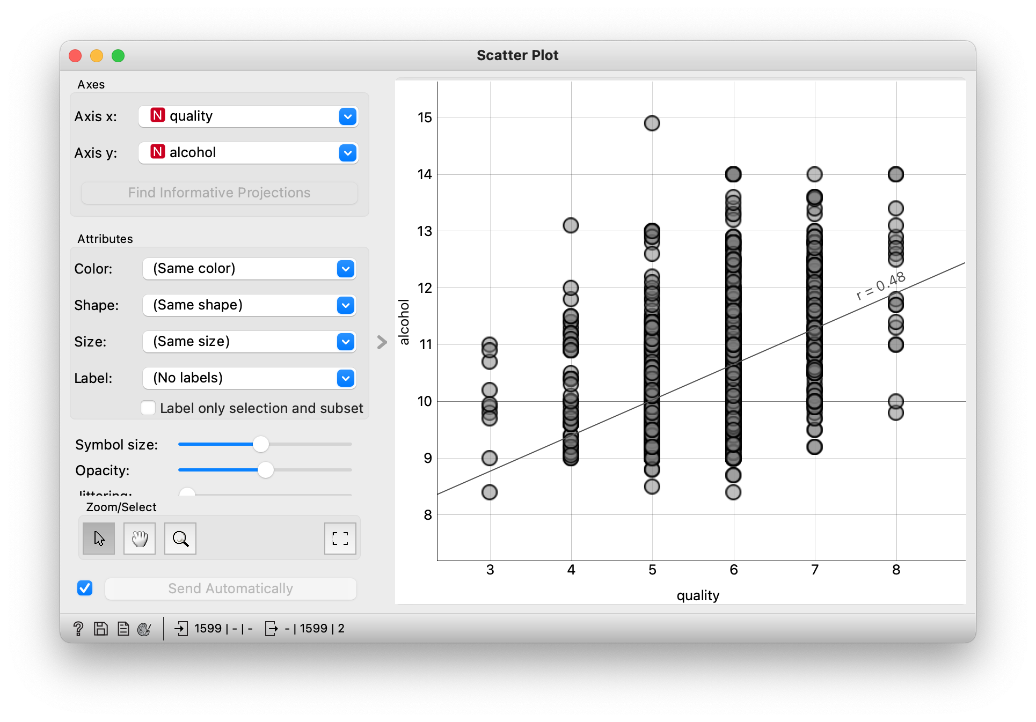
Goals
Predict the quality of different Portuguese “Vinho Verde” wine based on variables/attributes provided in the dataset.
Notes:
Fabio

Slide 3
Dataset / Attributes
Dataset:
Red Wine Quality: www.kaggle.com/uciml/red-wine-quality.
This dataset contains physicochemical and sensory data on red wine variants of the Portuguese “Vinho Verde” wine.
Attributes:
Input variables: Volatile acidity, total sulfur dioxide, density, chlorides, pH, free sulfur dioxide, residual sugar, fixed acidity, citric acid, sulphates, alcohol.
Output variable: Quality
Notes:
Fabio

Slide 4
Dataset / Attributes
Volatile Acidity : Acidic elements of a wine that are gaseous, rather than liquid, and therefore can be sensed as a smell. Volatile acids are produced through microbial action such as yeast fermentation, malolactic fermentation, and other fermentations carried out by spoilage organisms.
Total Sulfur Dioxide: Preserves wine’s freshness and fruit characters by virtue of antioxidant, antimicrobial and anti-enzymatic properties.
Density: Concentration of alcohol, sugar, glycerol, and other dissolved solids.
Chlorides: Amount of salt in the wine
pH: Measure of the concentration of free hydrogen ions in solution. About 3.0 to 3.4 is desirable for white wines, while about 3.3 to 3.6 is best for reds.
Free Sulfur Dioxide: The portion of SO2 that is free in the wine plus the portion that is bound to other chemicals in the wine such as sugar. It prevents the wine from reacting with oxygen which can cause browning and off-odors (oxidation), and it inhibits the growth of bacteria and undesirable wild yeasts in the grape juice and wine.
Residual Sugar: The natural grape sugars left over in a wine after the alcoholic fermentation is complete.
Fixed Acidity: The combined sum of titratable and volatile acids present.
Citric Acid: Citric acid imparts a citric character that enhances the taste of many white and blush wines.
Sulphates: Natural by-product of the fermentation process that work as a preservative against certain yeast and bacteria
Alcohol: Fortified wines range from 15.5% to 25% ABV, with an average of 18%. Typically about 12%
Notes:
Fabio

Slide 5
Data Preprocessing
The dataset has already been cleaned, so there was no need to apply additional data cleaning. Only discretization was performed.
The dataset was automatically discretized from a range of numeric attributes into nominal by using the first-last method in WEKA.
Then, I created a new categorical attribute, Quality Category, using the Wine Quality numeric inputs. I used an IF statement in Excel to split the numerical quality values into three classes: Poor, Good, and Excellent. The original quality category was removed from the dataset.
Notes:
Tyler. There were no outliers, there were no missing data.

Slide 6
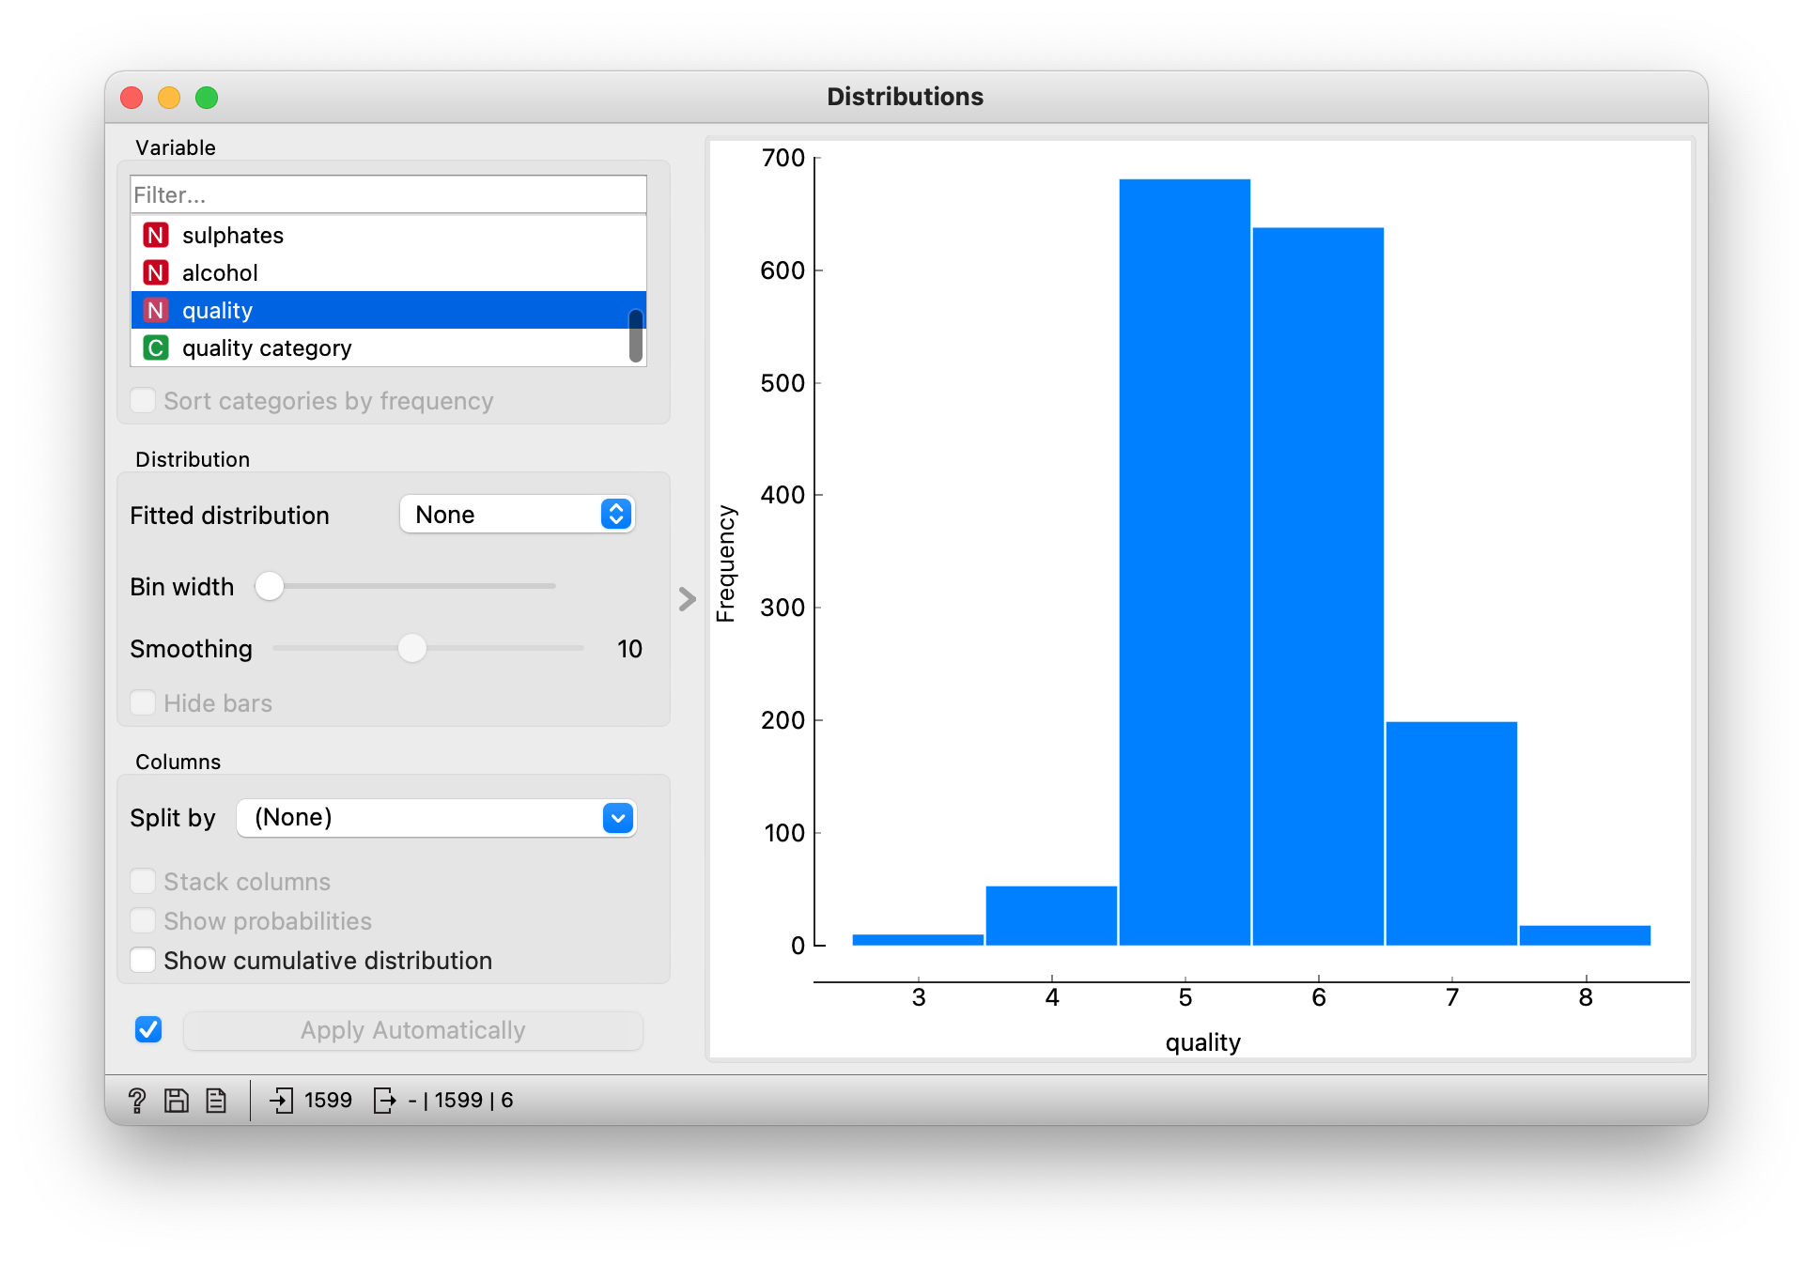
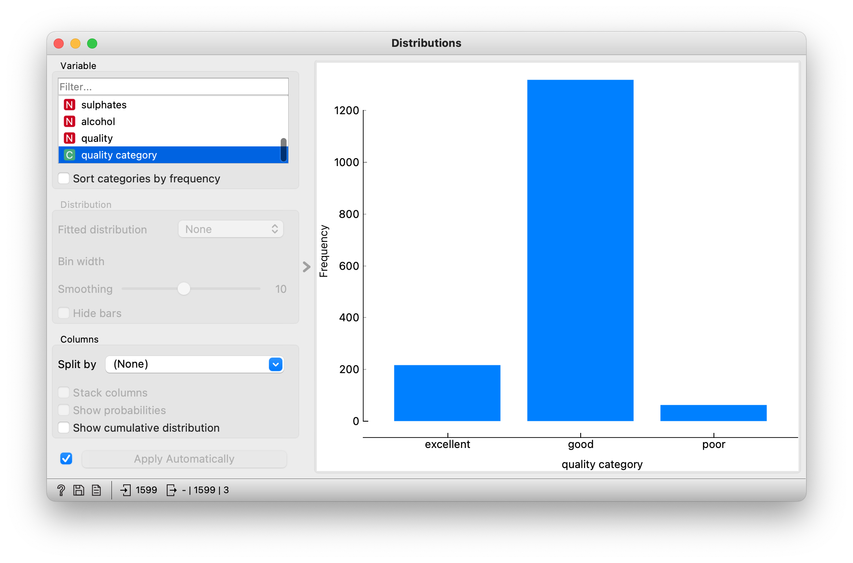
Data Preprocessing
Wine Quality Distribution
Wine Category Distribution
Wine Quality Feature Characteristics:
Mean: 5.64
Median: 6
Min: 3
Max: 8
Notes:
Tyler. Our target variable is wine quality. Each datapoint represents a wine, and the quality of the wine is scored between 0 (very bad) and 10 (excellent).

Slide 7
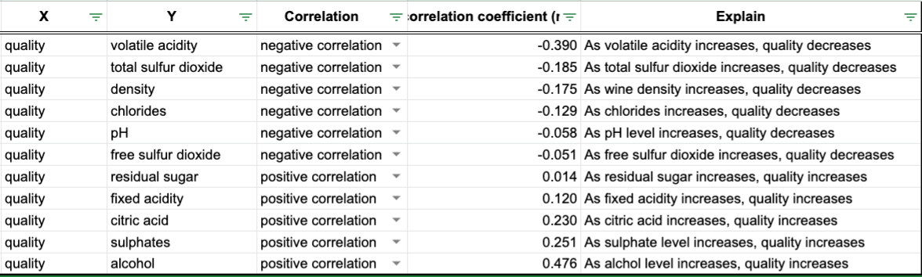
Data Analysis
Our goal is to identify which attributes are responsible for producing excellent quality wine. We used Orange to calculate the r value of each attribute on wine quality.
Notes:
Tyler. We found the Alcohol and Sulphates had the most positive effect on Wine Quality. Volatile Acidity had the largest negative effect.

Slide 8
Data Analysis
Now that we have an understanding of which attributes are correlated with higher wine quality, the next step is to conduct classification experiments to get the bigger picture. We applied 4 different classification methods using Weka.
In Weka, the datasets are separated into training and testing sets by using 10-fold cross validation. The training data is portioned into 10 sets of equal size and the algorithms executed 10 times.
Notes:
Tyler. We conducted a classification experiment to attempt to determine which attributes influenced the quality of a wine. We applied 4 different classification methods. The datasets are separated into training and testing sets by using 10-fold cross-validation. The training data is portioned into 10 sets of equal size and the algorithms executed 10 times.

Slide 9
Model Training & Testing
Some of the classification methods that we have used in our model training and model testing using Weka that allows for solving data mining problems are as follows;
Trees/J48
Trees/RandomForest
Function/SMO
Bayes/Naive Bayes
Notes:
Mehmet.

Slide 10
Classification Methods - J48 & Naive Bayes
The J48 algorithm is used to categorize many applications and produce accurate classification results thus is one of the best machine learning algorithms for categorizing and continuously examining data. It’s a implementation of C4.5 algorithm and generates a decision tree. It chooses the most effective attribute that can split its samples into sublets.
The Naive Bayes algorithm is one of the most simplistic and popular classification algorithm that figures out the possibility of the event based on the prior knowledge of happening. It uses Bayes’ theorem which is P(A|B) = (P(B|A) * P (A)) / P (B). It assumes that all input values are nominal, and numerical inputs are supported by assuming a distribution.
Notes:
Mehmet.

Slide 11
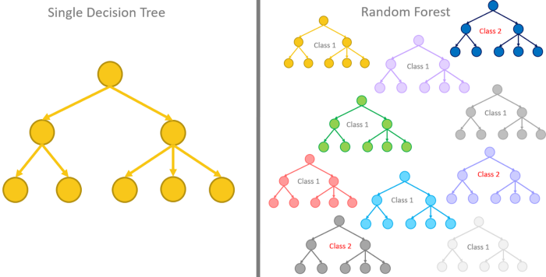
Classification Methods - Random forest
Another decision tree method just like J48 is Random forest. Random forest grows many classification trees unlike other ones who construct only one single classification tree. Which makes Random forest algorithm predict more accurate results. Algorithm usually have low correlation among the decision trees.
Notes:
Mehmet.

Slide 12
Classification Methods - SMO
SMO is short for sequential minimal optimization and is an algorithm method for overcoming the quadratic programming problems that occurs during training a support vector classifier. SMO is also used in LIBSVM tool.
Notes:
Mehmet.

Slide 13
Results
We measure the success of the classification experiment by accuracy percentage of classifying the instances correctly into its quality category. We found that using J48 we achieved 84% accuracy, Bayes achieved 78% accuracy, Random Forest method achieved 87% accuracy, and the SMO method received 82% accuracy.

Slide 14
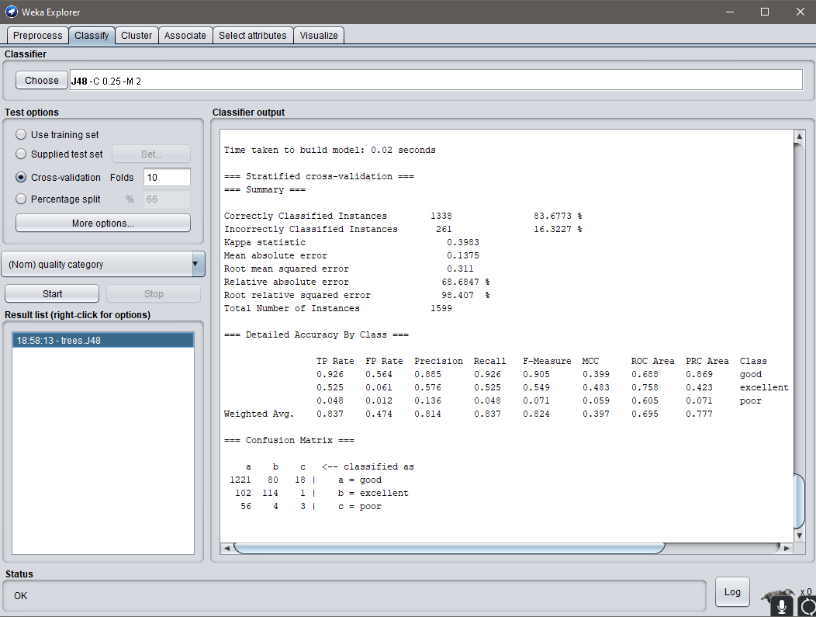
J48

Slide 15
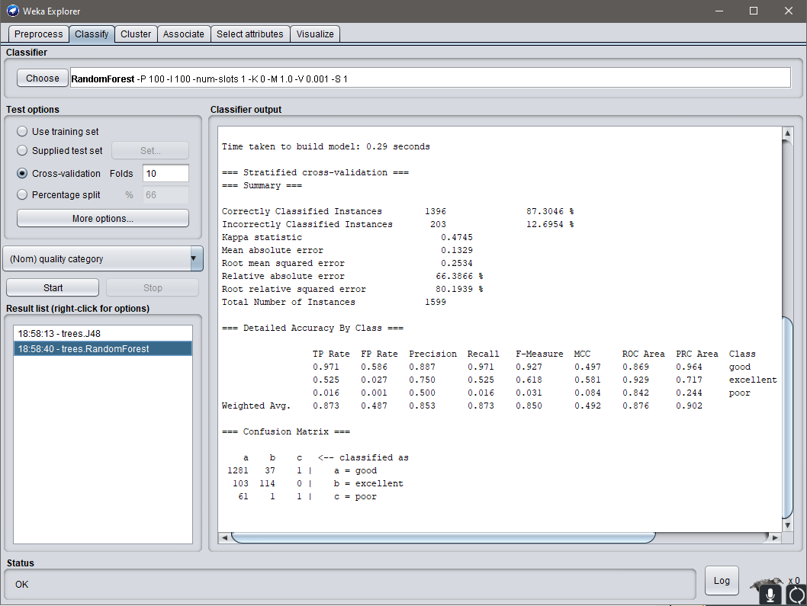
Random
forest

Slide 16
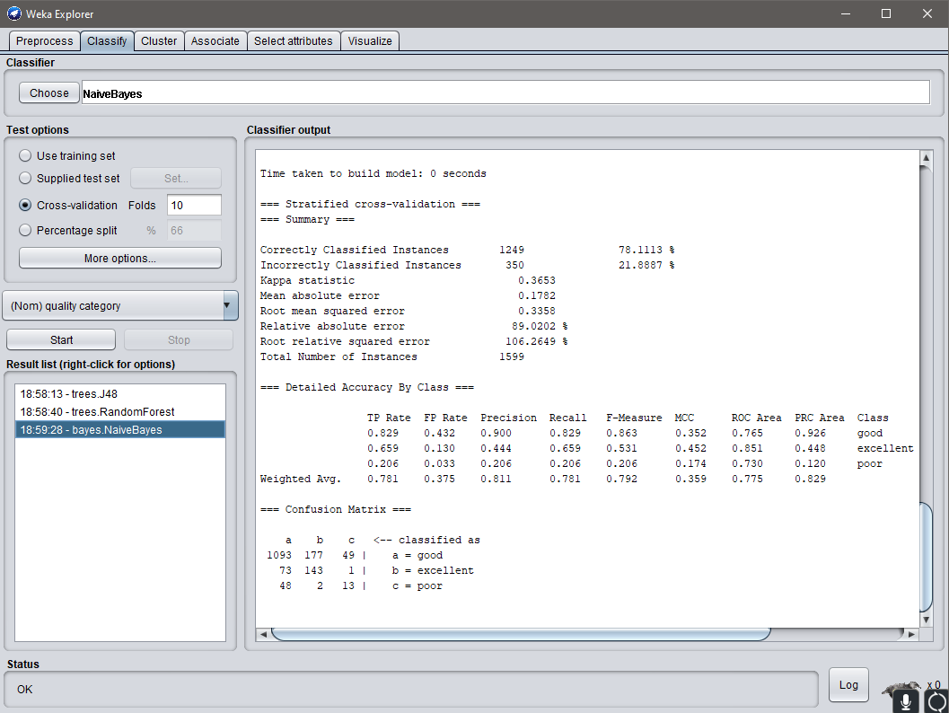
Naive
Bayes

Slide 17
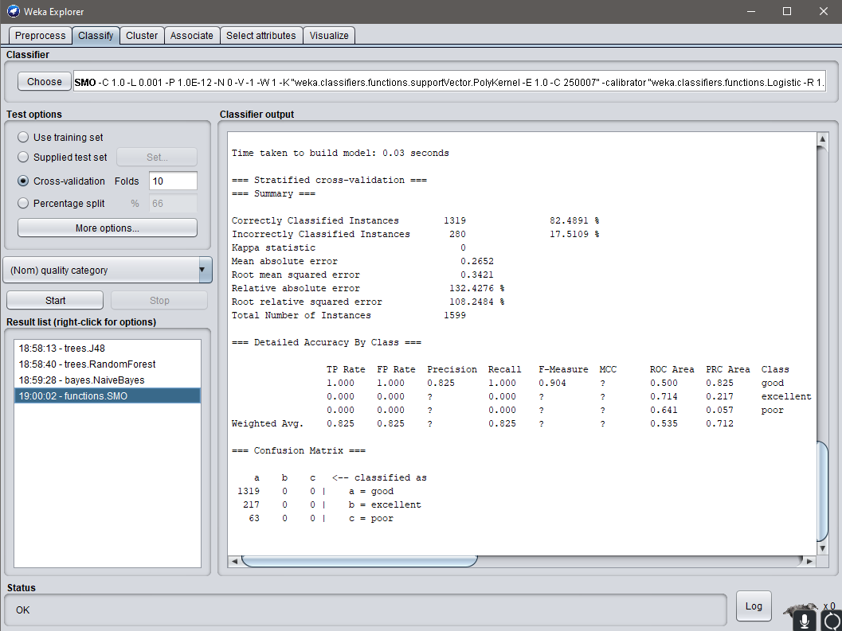
SMO

Slide 18
What’s Next?
Start working on project final presentation
Meet with group members to create an outline for the final presentation
Figure what the problem and methodology framework to solve the problem is going to be
Do more testing and training using different inputs, and removing irrelevant attributes
Build models for the dataset
Notes:
Mehmet.

Slide 19
Questions?

